Slide 1
Module – 3
ML Concepts, Algorithms & Model Evaluation
Dr. Rakhee Chhibber

Slide 2
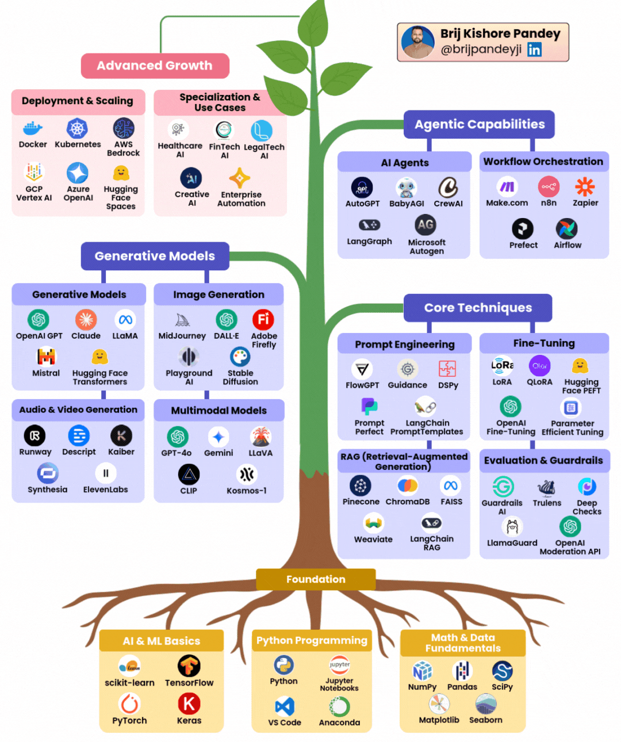
The Skill Tree You need to grow in Gen - AI

Slide 3
Module 3: Machine Learning
1. ML Concepts | 2. ML Algorithms
Supervised vs Unsupervised Semi-supervised Reinforcement learning basics ML workflow Feature engineering Model training, validation, testing Hyperparameter tuning | Linear & Logistic Regression KNN Decision Trees & Random Forest SVM Ensemble Learning KMeans, DBSCAN PCA
3. Model Evaluation | 4. Tools And Assignments
Classification metrics Regression metrics Confusion matrix ROC/AUC | ✔ Scikit-learn, Jupyter Assignments Build regression & classification models Fraud detection model Clustering customer segmentation

Slide 4
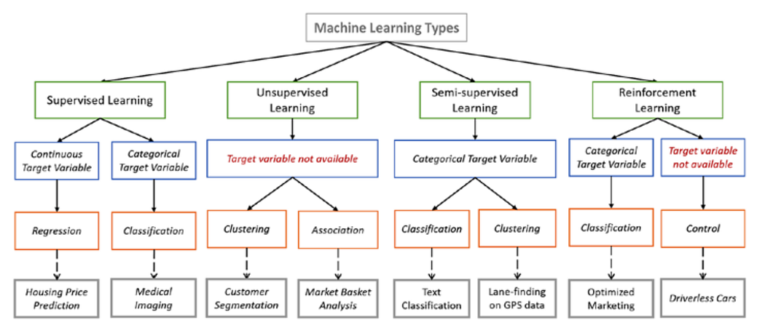

Slide 5
Unsupervised Learning

Slide 6
Introduction
Unsupervised Learning is a type of machine learning where the model works without labelled data. It learns patterns on its own by grouping similar data points or finding hidden structures without any human intervention.
It is used for tasks like clustering, dimensionality reduction and Association Rule Learning.
Helps identify hidden patterns in data
Useful for grouping, compression and anomaly detection

Slide 7
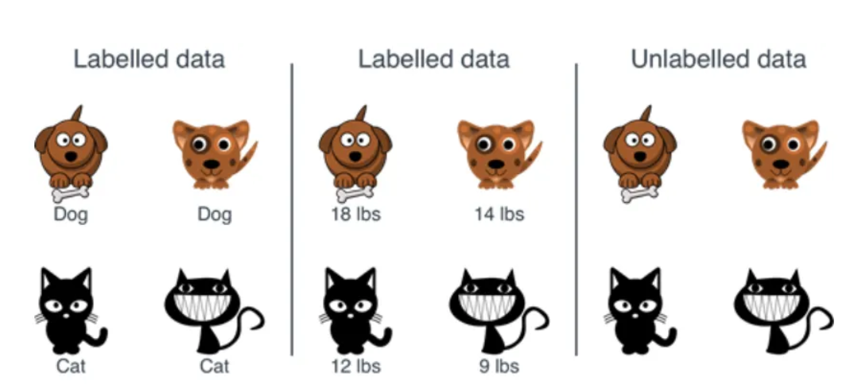

Slide 8
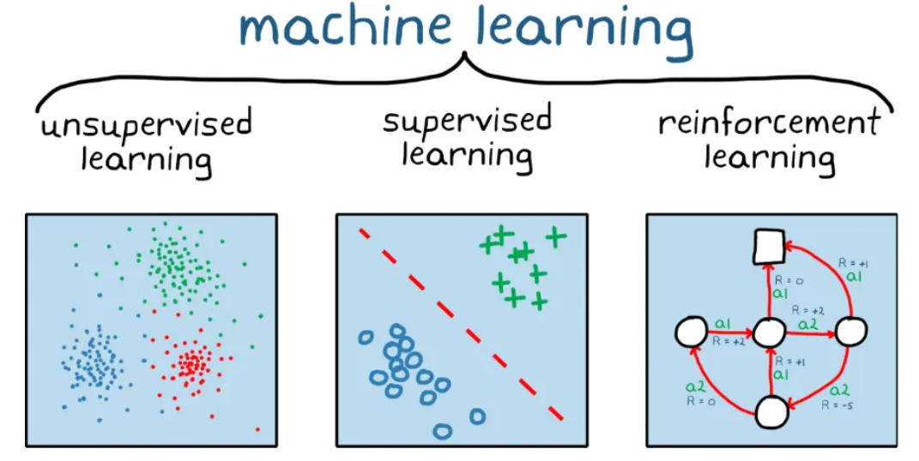

Slide 9
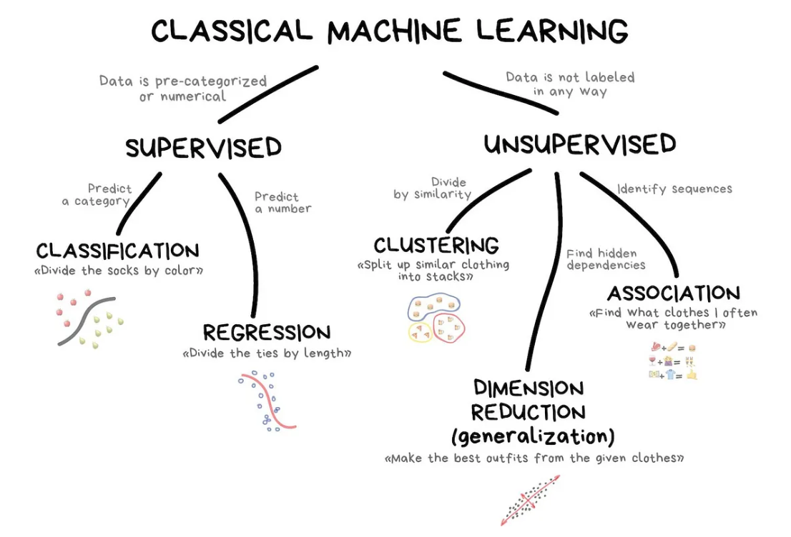

Slide 10
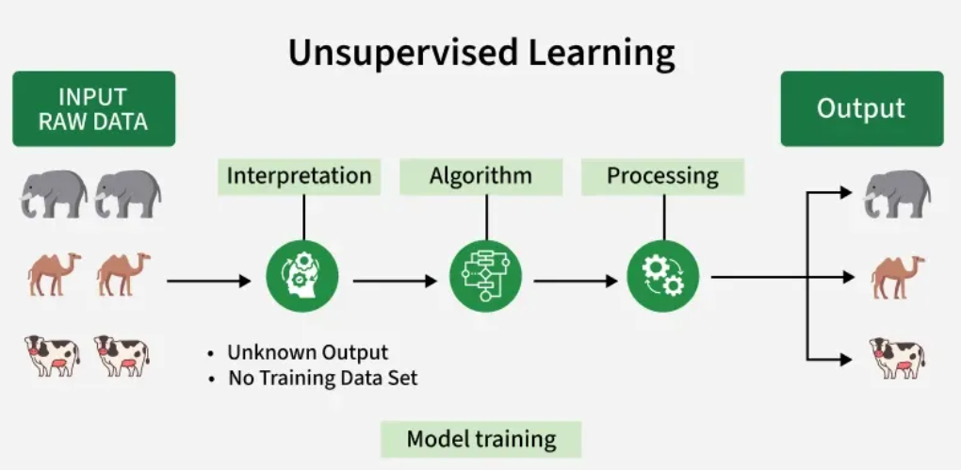
The "Interpretation" stage signifies that the algorithm doesn't have predefined labels or categories for the data. It needs to figure out how to group or organize the data based on inherent patterns.
An algorithm represents unsupervised learning process that helps to identify patterns in the data.
The processing stage shows the algorithm working on the data.

Slide 11
Working of Unsupervised Learning
1. Collect Unlabeled Data - Gather a dataset without predefined labels or categories.
Example: Images of various animals without any tags.
2. Select an Algorithm - such as clustering like K-Means, association rule learning like Apriori or dimensionality reduction like PCA based on the goal.
3. Train the Model on Raw Data - Feed the entire unlabeled dataset to the algorithm.
The algorithm looks for similarities, relationships or hidden structures within the data.
4. Group or Transform Data - The algorithm organizes data into groups (clusters), rules or lower-dimensional forms without human input.
Example: It may group similar animals together or extract key patterns from large datasets.
5. Interpret and Use Results -Analyze the discovered groups, rules or features to gain insights or use them for further tasks like visualization, anomaly detection or as input for other models.

Slide 12
Unsupervised Learning Algorithms
1. Clustering Algorithms
K-means Clustering: Groups data into K clusters based on how close the points are to each other.
Hierarchical Clustering: Creates clusters by building a tree step-by-step, either merging or splitting groups.
Density-Based Clustering (DBSCAN): Finds clusters in dense areas and treats scattered points as noise.
2. Association Rule Learning
Apriori Algorithm: Finds patterns by exploring frequent item combinations step-by-step.
FP-Growth Algorithm: An Efficient Alternative to Apriori. It quickly identifies frequent patterns without generating candidate sets.
Eclat Algorithm: Uses intersections of itemsets to efficiently find frequent patterns.
Efficient Tree-based Algorithms: Scales to handle large datasets by organizing data in tree structures.
3. Dimensionality Reduction
Principal Component Analysis (PCA): Reduces dimensions by transforming data into uncorrelated principal components.
Linear Discriminant Analysis (LDA): Reduces dimensions while maximizing class separability for classification tasks.

Slide 13
Applications of Unsupervised learning
Customer Segmentation: Algorithms cluster customers based on purchasing behavior or demographics, enabling targeted marketing strategies.
Anomaly Detection: Identifies unusual patterns in data, aiding fraud detection, cybersecurity and equipment failure prevention.
Recommendation Systems: Suggests products, movies or music by analyzing user behavior and preferences.
Image and Text Clustering: Groups similar images or documents for tasks like organization, classification or content recommendation.
Social Network Analysis: Detects communities or trends in user interactions on social media platforms

Slide 14
Business Use Cases
Domain | Use Case
Marketing | Customer segmentation
Banking | Fraud detection
Healthcare | Disease subtype discovery
Retail | Product categorization
Image Processing | Image segmentation
NLP | Document clustering
IoT | Sensor pattern detection

Slide 15
Principal component analysis (PCA)
It is the process of computing the principal components then using them to perform a change of basis on the data. In other words, PCA is an unsupervised learning dimensionality reduction technique.
It’s useful to reduce the dimensionality of a dataset for two main reasons:
When there are too many dimensions in a dataset to visualize
To identify the most predictive n dimensions for feature selection when building a predictive model.

Slide 16
PCA - Example
from sklearn.datasets import load_iris # Dataset
from sklearn.decomposition import PCA # Algorithm
import matplotlib.pyplot as plt # Visualization
# Load the data
iris_data = load_iris(as_frame=True)
# Preview
iris_data.data.head()

Slide 17
plt.rcParams["figure.figsize"] = [7.00, 3.50]
plt.rcParams["figure.autolayout"] = True
fig = plt.figure()
ax = fig.add_subplot(111, projection='3d')
sepal_length = iris_data.data["sepal length (cm)"]
sepal_width = iris_data.data["sepal width (cm)"]
petal_length = iris_data.data["petal length (cm)"]
petal_width = iris_data.data["petal width (cm)"]
ax.scatter(sepal_length, sepal_width, petal_length, c=petal_width)
plt.show()

Slide 18
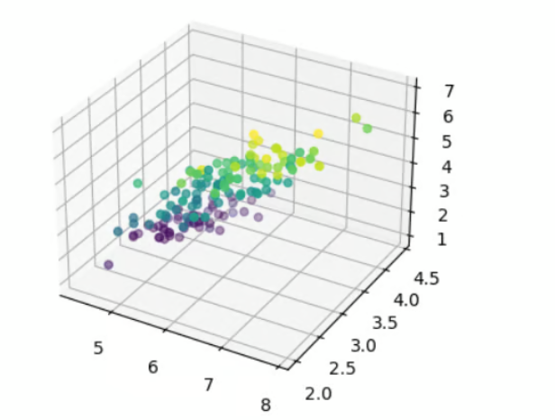
It’s quite difficult to get insights from this visualization because all of the inststances are jumbled together since we only have access to one viewpoint when we visualize data in three dimensions in this scenario.
With PCA, we can reduce the dimensions of the data down to two, which would then make it easier to visualize our data and tell apart the classes.

Slide 19
# Instantiate PCA with 2 components
pca = PCA(n_components=2)
# Train the model
pca.fit(iris_data.data)
iris_data_reduced = pca.fit_transform(iris_data.data)
# Plot data
plt.scatter(
iris_data_reduced[:,0],
iris_data_reduced[:,1],
c=iris_data.target
)
plt.show()

Slide 20
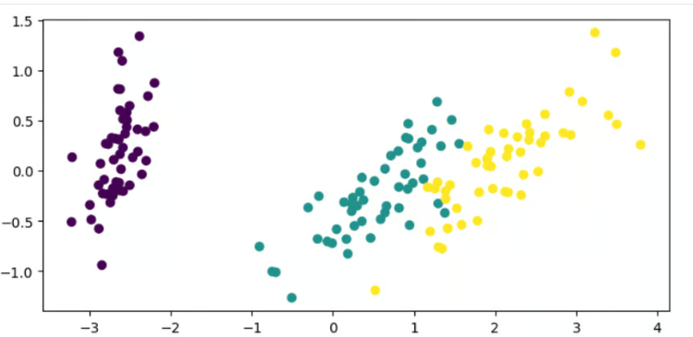

Slide 21
K-Mean Clustering
K-Means Clustering groups similar data points into clusters without needing labeled data. It is used to uncover hidden patterns when the goal is to organize data based on similarity.
  Helps identify natural groupings in unlabeled datasets
  Works by grouping points based on distance to cluster centers
  Commonly used in customer segmentation, image compression, and pattern discovery
  Useful when you need structure from raw, unorganized data

Slide 22
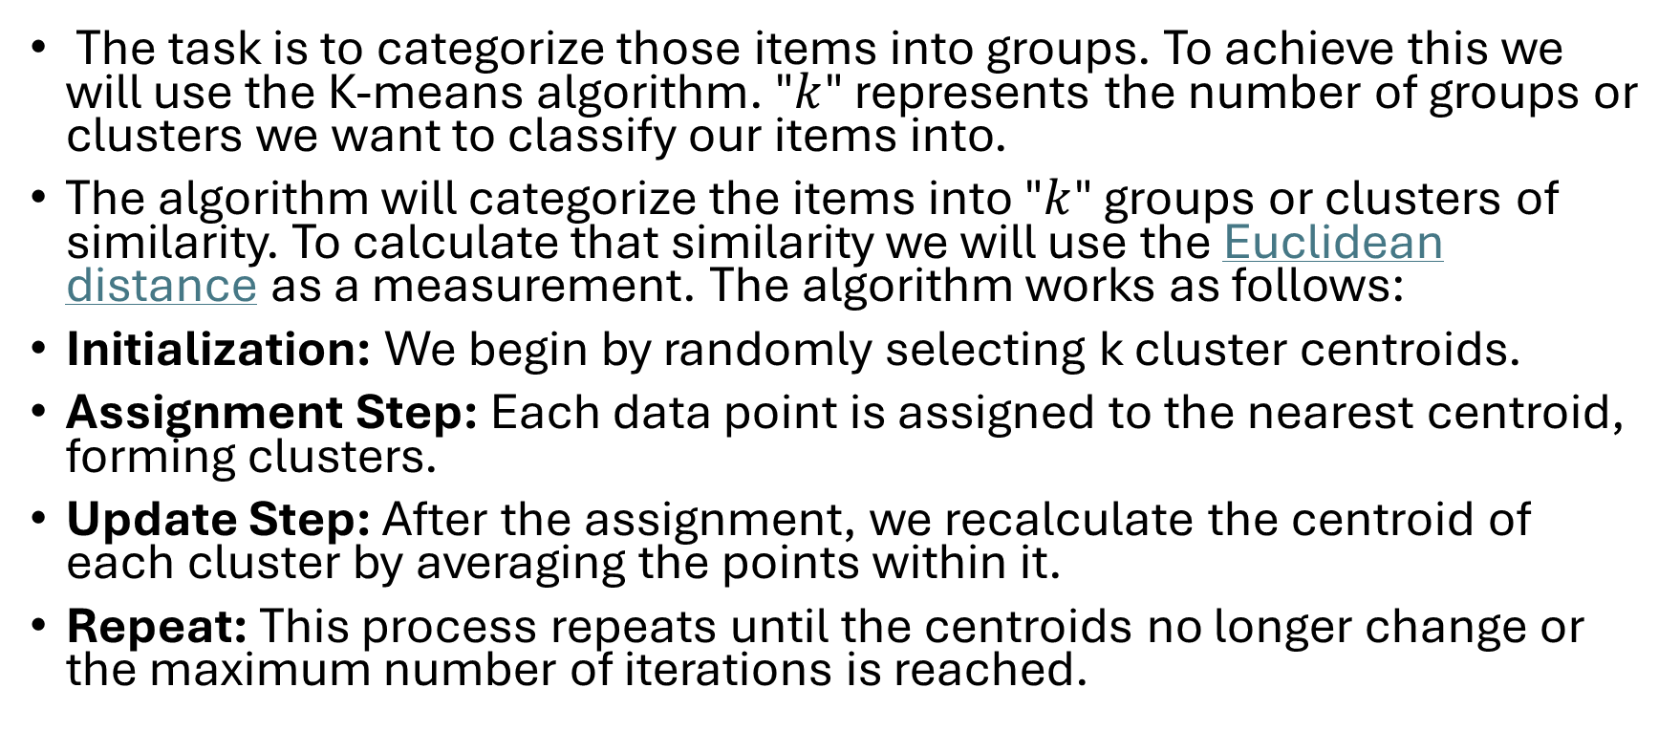
Working of K-Means Clustering
The task is to categorize those items into groups. To achieve this we will use the K-means algorithm. "$k$" represents the number of groups or clusters we want to classify our items into.
The algorithm will categorize the items into "$k$" groups or clusters of similarity. To calculate that similarity we will use the Euclidean distance as a measurement. The algorithm works as follows:
Initialization: We begin by randomly selecting k cluster centroids.
Assignment Step: Each data point is assigned to the nearest centroid, forming clusters.
Update Step: After the assignment, we recalculate the centroid of each cluster by averaging the points within it.
Repeat: This process repeats until the centroids no longer change or the maximum number of iterations is reached.

Slide 23



Euclidean Distance
It is defined as the distance between two points in Euclidean space. To find the distance between two points, the length of the line segment that connects the two points should be measured.
Euclidean distance is like measuring the straightest and shortest path between two points.
ED in 2D
ED in 3D
Ed in nD

Slide 24
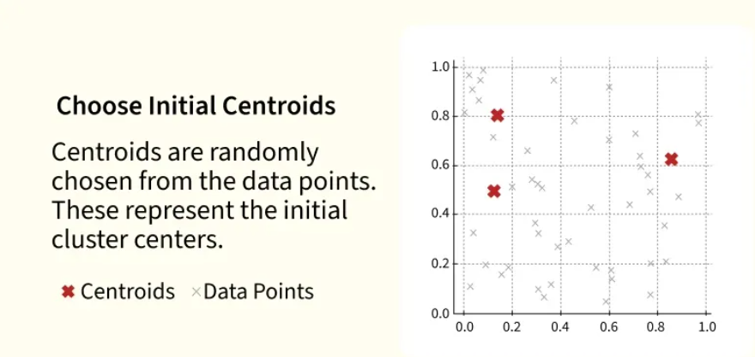
Step 1

Slide 25
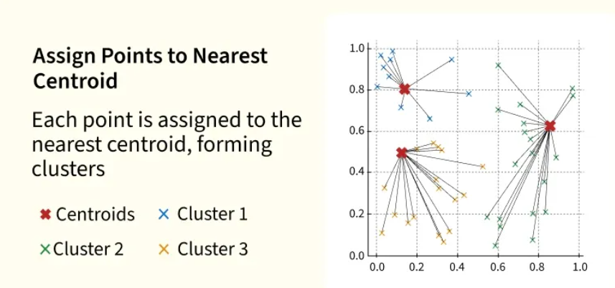
Step 2

Slide 26
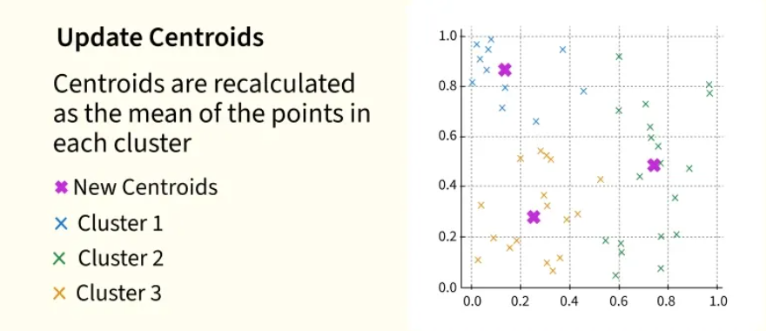
Step 3

Slide 27
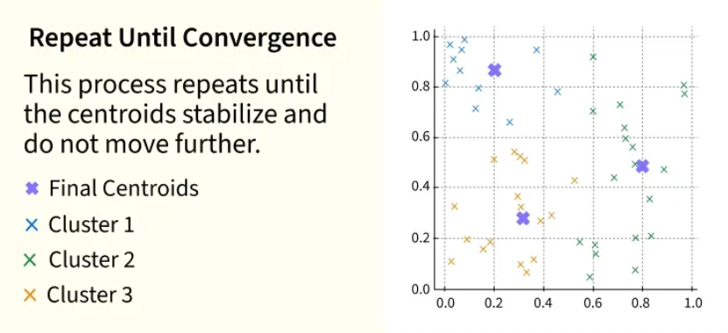
Step 4

Slide 28
Step 1
import numpy as np
import matplotlib.pyplot as plt
from sklearn.datasets import make_blobs
2. Step 2
make_blobs(n_samples=500, n_features=2, centers=3): Generates 500 data points in a 2D space, grouped into 3 clusters.
plt.scatter(X[:, 0], X[:, 1]): Plots the dataset in 2D, showing all the points.
plt.show(): Displays the plot
X,y = make_blobs(n_samples = 500,n_features = 2,centers = 3,random_state = 23)
fig = plt.figure(0)
plt.grid(True)
plt.scatter(X[:,0],X[:,1])
plt.show()

Slide 29
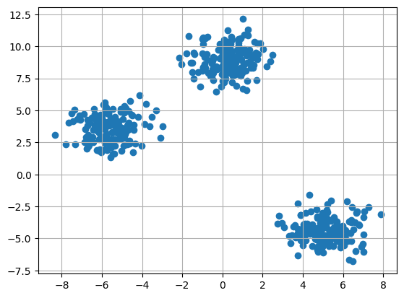

Slide 30
Step 3: Initializing Random Centroids
We will randomly initialize the centroids for K-Means clustering
np.random.seed(23): Ensures reproducibility by fixing the random seed.
The for loop initializes k random centroids, with values between -2 and 2, for a 2D dataset
k = 3
clusters = {}
np.random.seed(23)
for idx in range(k):
center = 2*(2*np.random.random((X.shape[1],))-1)
points = []
cluster = {
'center' : center,
'points' : []
}
clusters[idx] = cluster
clusters

Slide 31
Step 4: Plotting Random Initialized Center with Data Points
We will now plot the data points and the initial centroids.
plt.grid(): Plots a grid.
plt.scatter(center[0], center[1], marker='*', c='red'): Plots the cluster center as a red star (* marker).
plt.scatter(X[:,0],X[:,1])
plt.grid(True)
for i in clusters:
center = clusters[i]['center']
plt.scatter(center[0],center[1],marker = '*',c = 'red')
plt.show()

Slide 32


Slide 33
Step 5: Defining Euclidean Distance
To assign data points to the nearest centroid, we define a distance function:
np.sqrt(): Computes the square root of a number or array element-wise.
np.sum(): Sums all elements in an array or along a specified axis
def distance(p1,p2):
return np.sqrt(np.sum((p1-p2)**2))

Slide 34
Step 6: Creating Assign and Update Functions
Next, we define functions to assign points to the nearest centroid and update the centroids based on the average of the points assigned to each cluster.
dist.append(dis): Appends the calculated distance to the list dist.
curr_cluster = np.argmin(dist): Finds the index of the closest cluster by selecting the minimum distance.
new_center = points.mean(axis=0): Calculates the new centroid by taking the mean of the points in the cluster.

Slide 35
def assign_clusters(X, clusters):
for idx in range(X.shape[0]):
dist = []
curr_x = X[idx]
for i in range(k):
dis = distance(curr_x,clusters[i]['center'])
dist.append(dis)
curr_cluster = np.argmin(dist)
clusters[curr_cluster]['points'].append(curr_x)
return clusters
def update_clusters(X, clusters):
for i in range(k):
points = np.array(clusters[i]['points'])
if points.shape[0] > 0:
new_center = points.mean(axis =0)
clusters[i]['center'] = new_center
clusters[i]['points'] = []
return clusters

Slide 36
Step 7: Predicting the Cluster for the Data Points
We create a function to predict the cluster for each data point based on the final centroids.
pred.append(np.argmin(dist)): Appends the index of the closest cluster (the one with the minimum distance) to pred.
def pred_cluster(X, clusters):
pred = []
for i in range(X.shape[0]):
dist = []
for j in range(k):
dist.append(distance(X[i],clusters[j]['center']))
pred.append(np.argmin(dist))
return pred

Slide 37
Step 8: Assigning, Updating and Predicting the Cluster Centers
We assign points to clusters, update the centroids and predict the final cluster labels.
  assign_clusters(X, clusters): Assigns data points to the nearest centroids.
  update_clusters(X, clusters): Recalculates the centroids.
  pred_cluster(X, clusters): Predicts the final clusters for all data points.
clusters = assign_clusters(X,clusters)
clusters = update_clusters(X,clusters)
pred = pred_cluster(X,clusters)

Slide 38
Step 9: Plotting Data Points with Predicted Cluster Centers
Finally, we plot the data points, colored by their predicted clusters, along with the updated centroids.
center = clusters[i]['center']: Retrieves the center (centroid) of the current cluster.
plt.scatter(center[0], center[1], marker='^', c='red'): Plots the cluster center as a red triangle (^ marker).
plt.scatter(X[:,0],X[:,1],c = pred)
for i in clusters:
center = clusters[i]['center']
plt.scatter(center[0],center[1],marker = '^',c = 'red')
plt.show()

Slide 39
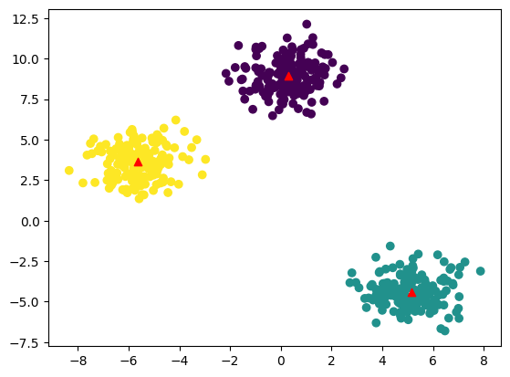

Slide 40
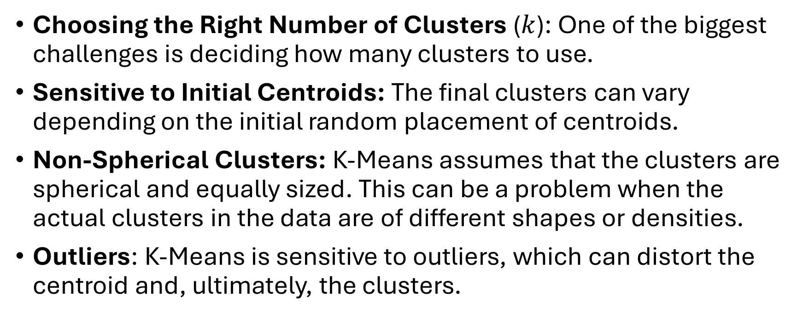
Challenges with K-Means Clustering
Choosing the Right Number of Clusters ($k$): One of the biggest challenges is deciding how many clusters to use.
Sensitive to Initial Centroids: The final clusters can vary depending on the initial random placement of centroids.
Non-Spherical Clusters: K-Means assumes that the clusters are spherical and equally sized. This can be a problem when the actual clusters in the data are of different shapes or densities.
Outliers: K-Means is sensitive to outliers, which can distort the centroid and, ultimately, the clusters.

Slide 41
Elbow Method for optimal value of k in KMeans
In K-Means clustering, the algorithm partitions data into k clusters by minimizing the distances between points and their cluster centroids. However, deciding the ideal k is not straightforward. The Elbow Method helps by plotting the Within-Cluster Sum of Squares (WCSS) against increasing k values and looking for a point where the improvement slows down, this point is called the "elbow."

Slide 42
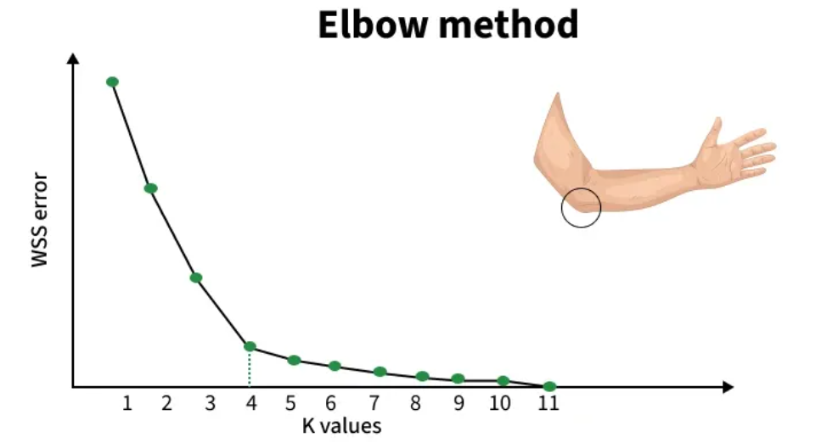

Slide 43

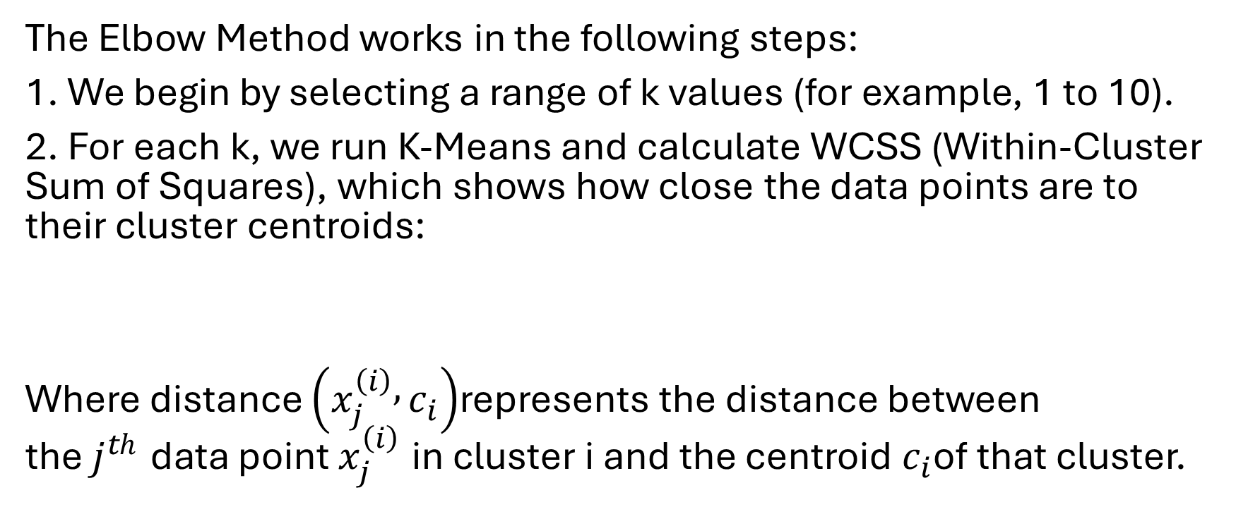
Working of Elbow Point
The Elbow Method works in the following steps:
1. We begin by selecting a range of k values (for example, 1 to 10).
2. For each k, we run K-Means and calculate WCSS (Within-Cluster Sum of Squares), which shows how close the data points are to their cluster centroids:
Where $\text{distance}\left(x_{j}^{\left(i\right)} , c_{i}\right)$represents the distance between the $j^{th}$ data point $x_{j}^{\left(i\right)}$​ in cluster i and the centroid $c_{i}$of that cluster.

Slide 44
3. After computing WCSS for all k values, we plot k vs WCSS.
4. WCSS always decreases as k increases because more clusters reduce the internal spread.
5. However, after a certain point, the improvement becomes very small. This bend or “elbow” in the curve indicates the point where adding more clusters no longer gives meaningful improvement.
  Before the elbow: WCSS drops quickly -> clusters become much better.
  After the elbow: WCSS drops slowly -> extra clusters add little value and may lead to overfitting.

Slide 45
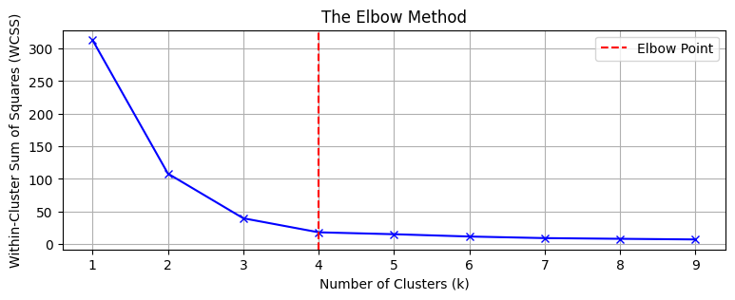

Slide 46
Import files
from sklearn.cluster import KMeans
from sklearn import metrics
from scipy.spatial.distance import cdist
import numpy as np
import matplotlib.pyplot as plt

Slide 47
Creating and Visualizing the data
x1 = np.array([3, 1, 1, 2, 1, 6, 6, 6, 5, 6,
7, 8, 9, 8, 9, 9, 8, 4, 4, 5, 4])
x2 = np.array([5, 4, 5, 6, 5, 8, 6, 7, 6, 7,
1, 2, 1, 2, 3, 2, 3, 9, 10, 9, 10])
X = np.array(list(zip(x1, x2))).reshape(len(x1), 2)
plt.scatter(x1, x2, marker='o')
plt.xlim([0, 10])
plt.ylim([0, 10])
plt.title('Dataset Visualization')
plt.xlabel('Feature 1')
plt.ylabel('Feature 2')
plt.show()

Slide 48
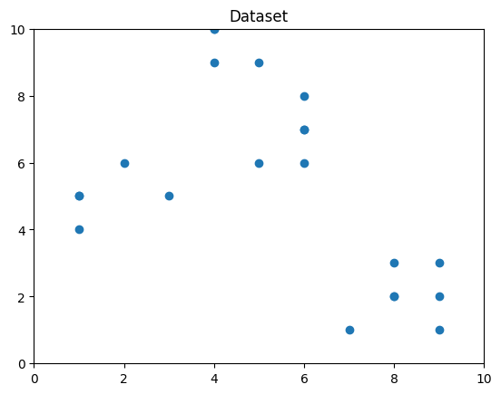
we can see that the optimal number of clusters should be around 3.

Slide 49
Building the Clustering Model
distortions = []
inertias = []
mapping1 = {}
mapping2 = {}
K = range(1, 10)
for k in K:
kmeanModel = KMeans(n_clusters=k, random_state=42).fit(X)
distortions.append(sum(np.min(cdist(X, kmeanModel.cluster_centers_, 'euclidean'), axis=1)**2) / X.shape[0])
inertias.append(kmeanModel.inertia_)
mapping1[k] = distortions[-1]
mapping2[k] = inertias[-1]

Slide 50
Tabulating and Visualizing the Results
Displaying Distortion Values
print("Distortion values:")
for key, val in mapping1.items():
print(f'{key} : {val}')
plt.plot(K, distortions, 'bx-')
plt.xlabel('Number of Clusters (k)')
plt.ylabel('Distortion')
plt.title('The Elbow Method using Distortion')
plt.show()

Slide 51
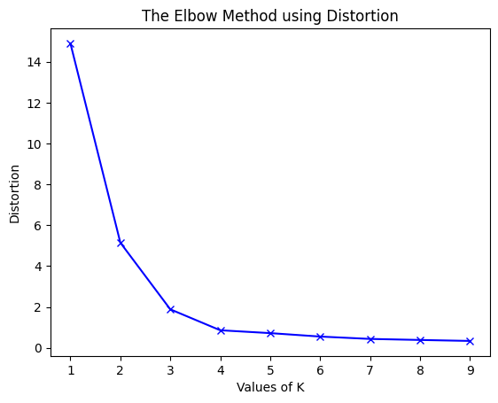

Slide 52
Displaying Inertia Values:
print("Inertia values:")
for key, val in mapping2.items():
print(f'{key} : {val}')
plt.plot(K, inertias, 'bx-')
plt.xlabel('Number of Clusters (k)')
plt.ylabel('Inertia')
plt.title('The Elbow Method using Inertia')
plt.show()

Slide 53
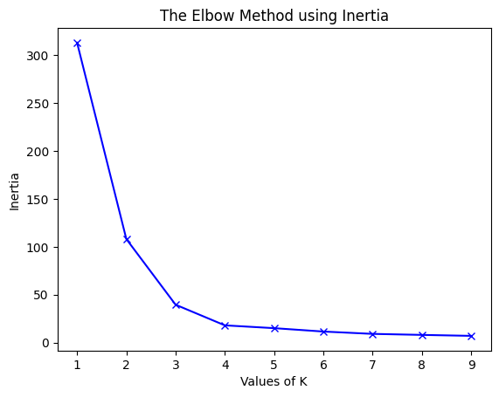

Slide 54
Clustered Data Points For Different k Values
k_range = range(1, 5)
for k in k_range:
kmeans = KMeans(n_clusters=k, init='k-means++', random_state=42)
y_kmeans = kmeans.fit_predict(X)
plt.scatter(X[:, 0], X[:, 1], c=y_kmeans, cmap='viridis', marker='o', edgecolor='k', s=100)
plt.scatter(kmeans.cluster_centers_[:, 0], kmeans.cluster_centers_[:, 1],
s=300, c='red', label='Centroids', edgecolor='k')
plt.title(f'K-means Clustering (k={k})')
plt.xlabel('Feature 1')
plt.ylabel('Feature 2')
plt.legend()
plt.grid()
plt.show()

Slide 55
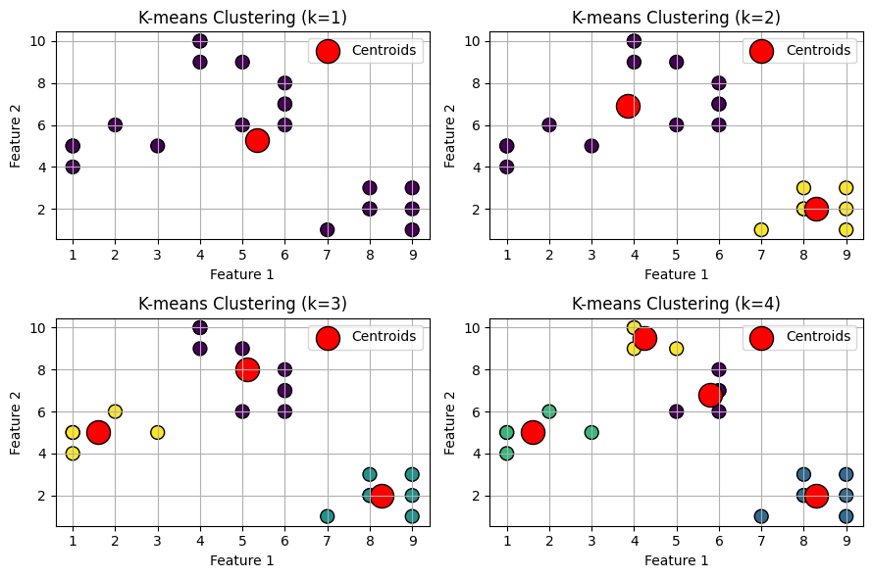

Slide 56
https://scikit-learn.org/stable/auto_examples/text/plot_document_classification_20newsgroups.html
https://scikit-learn.org/stable/auto_examples/text/plot_document_clustering.html

Slide 57
Thank you

